Slide 1


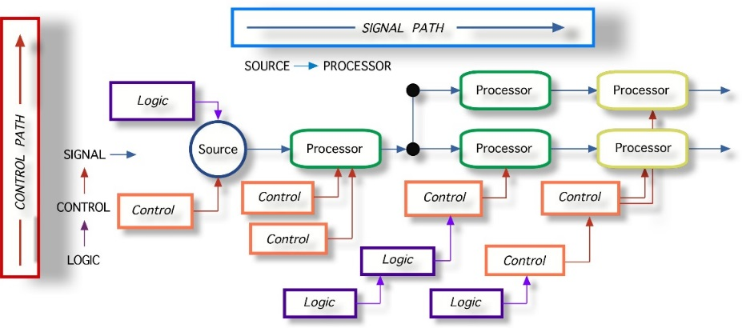
AMD and RequireJS
Splitting JavaScript into Dependent Modules
Telerik Software Academy
Learning & Development
http://academy.telerik.com

Slide 2
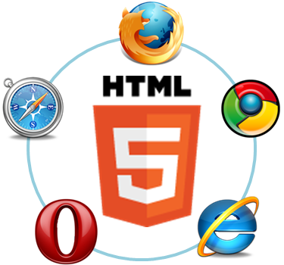
Table of Contents
AMD Overview
RequireJS Overview
Installation and configuration
Defining modules with RequireJS
Defining Dependent modules

Slide 3
AMD Overview

Slide 4
AMD Overview
Asynchronous module definition (AMD) is a JavaScript API for defining modules
And they are loaded asynchronously
Useful in improving the performance of websites
AMD allows to create dependent modules
Modules that need other modules to work
RequireJS is a famous AMD library
Runs both in the browser and in Node.js

Slide 5
Dive in RequireJS
How to create dependent modules?

Slide 6
RequireJS Overview
RequireJS is a JavaScript file and module loader
It is optimized for in-browser use
Yet it can be used in other JavaScript environments, like Rhino and Node
Modular loaders improve the speed and quality of code
Inspire lazy-loading of JS files
Makes files dependent on other files

Slide 7
RequireJS Overview (2)
Using RequireJS makes code more simpler and optimized
Instead of loading all the JavaScript files on the page load, load them when needed
Handles the many-scripts-hell in a web page
Load a single file/module (app.js)
And this file will require other files/modules
And these other modules will require more modules etc…

Slide 8
Using RequireJS

Slide 9
Using RequireJS
RequireJS needs a configuration file to load other files
The config file is the single JavaScript file in the web page
RequireJS loads all code relative to a baseUrl
The url given in data-main
RequireJS assumes by default that all dependencies are scripts
Suffix ".js" is not expected

Slide 10
Using RequireJS: Steps
To use RequireJS:
Fetch the require.js file:
Either download it from RequireJS web site
Or with bower:
Create an app.js file to start your application
Create an HTML page and src the RequireJS file
And set the data-main attribute to the app.js file
$ bower install requirejs
<script src="scripts/libs/require.js" data-main="scripts/app/app"></script>

Slide 11
The app.js file
The app.js is the file, that starts your application
It has dependencies to other RequreJS modules
//app.js
(function () {
require.config({
paths: {
"jquery": "libs/jquery-2.0.3"
}
});
require(["jquery"], function () {
//write your jQuery-dependent code here
});
}());

Slide 12

Using RequireJS
Live Demo

Slide 13

Defining Modules

Slide 14
Modules
A module is a well-scoped object that avoids polluting the global scope
It can explicitly list its dependencies and get a handle on those dependencies
Dependencies are received as arguments to the define function
The RequireJS module is an extension of the Module Pattern

Slide 15
Modules (2)
The RequireJS syntax for modules allows them to be loaded as fast as possible
Even out of order, yet evaluated in the correct dependency order
Since global variables are not created it is possible to load multiple versions of a module
There should only be one module definition in a single JavaScript file!
The modules can be grouped into optimized bundles by an optimization tool

Slide 16
Defining Modules
Defining modules is done using the define function of RequireJS:
The name of the modules is the path of the file
//in file "libs/module1.js"
define(function(){
//do stuff
return result; }
define({ properties });
Not all modules need dependencies
If no dependencies are needed, just pass a function handler or an object

Slide 17
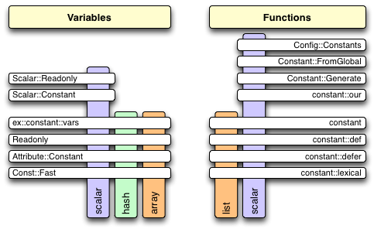
Defining Simple Modules
Live Demo

Slide 18
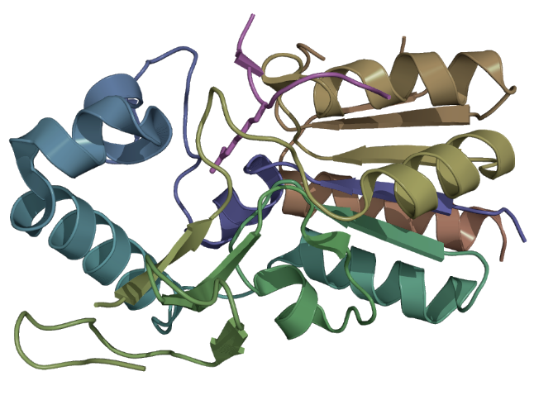
Defining Modules with Dependencies

Slide 19
Defining Dependencies
Some modules use another modules
RequireJS can "request" a file to be loaded
Pass the names of the required module as an array in the define function
If any of them is not loaded, RequireJS will load it

Slide 20
Defining Dependencies
Live Demo

Slide 21
RequireJS
http://academy.telerik.com

Slide 22
Homework
Implement a ComboBox control (like a dropdown list)
The ComboBox holds a set of items (an array)
Initially only a single item, the selected item, is visible (the ComboBox is collapsed)
When the selected item is clicked, all other items are shown (the ComboBox is expanded)
If an item is clicked, it becomes the selected item and the ComboBox collapses
Each of the items in a ComboBox can contain any valid HTML code

Slide 23
Homework (2)
(cont.) Implement a ComboBox control (like a dropdown list)
Use RequireJS and handlebars.js
jQuery is not obligatory (use it if you will)
The ComboBox should have the following usage:
var people = [
{ id: 1, name: "Doncho Minkov", age: 18, avatarUrl: "images/minkov.jpg" },
{ id: 2, name: "Georgi Georgiev", age: 19, avatarUrl: "images/joreto.jpg" }];
var comboBox = controls.ComboBox(people);
var template = $("#person-template").html();
var comboBoxHtml = comboBox.render(template);
container.innerHTML = comboBoxHtml;
//sample template
<div class="person-item" id="person-item-{{id}}">
<strong class="person-name">{{name}}</strong><p class="person-age">{{age}}</p>
<img src="{{avatarUrl}}" width="100px" />
</div>

